Slide 1
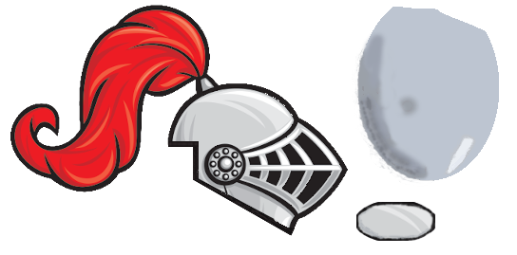
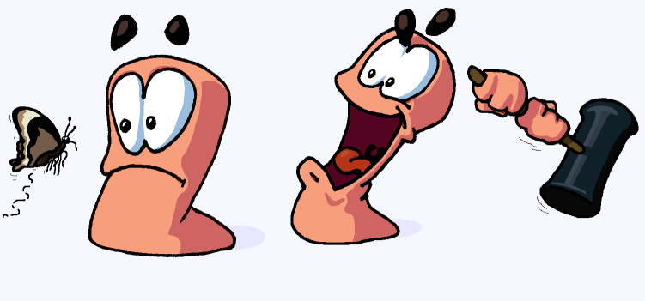
We present you the
New-Never-Before-Seen-Game:
Worms
smroW
By:
Alex ogillbee
Joseph Hill
Fernando Trevino

Slide 2
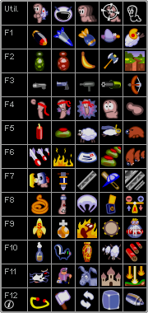
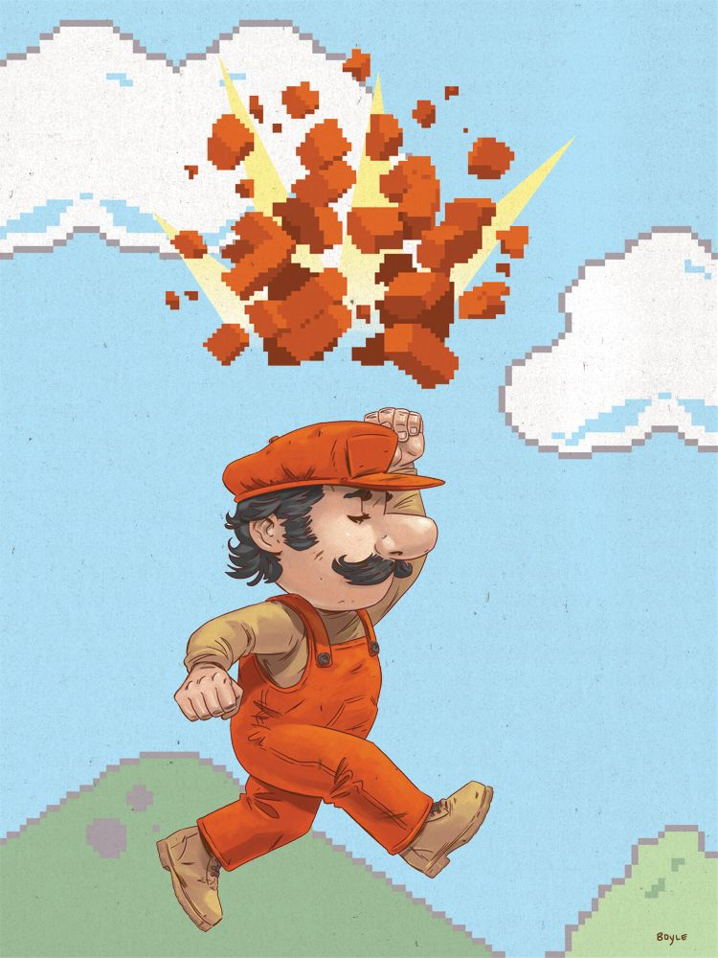
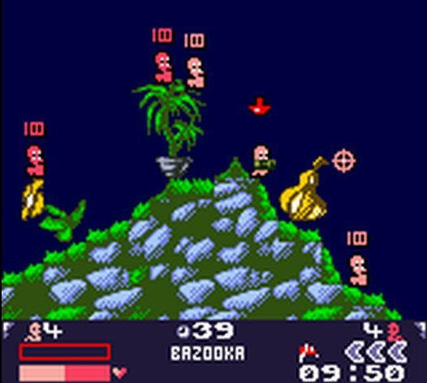
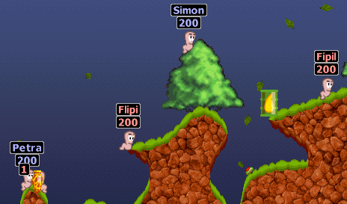
Game explanation
2D turn-based tactical shooter, inspired by Worms
Tile-based map
Each tile has its own health, not always destroyed on impact
Each map will have different environment behavior and hazards
Special weapons

Slide 3

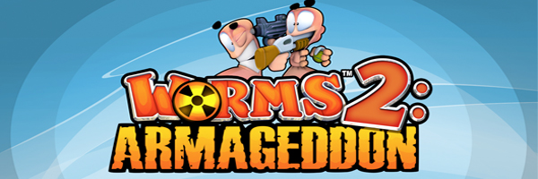
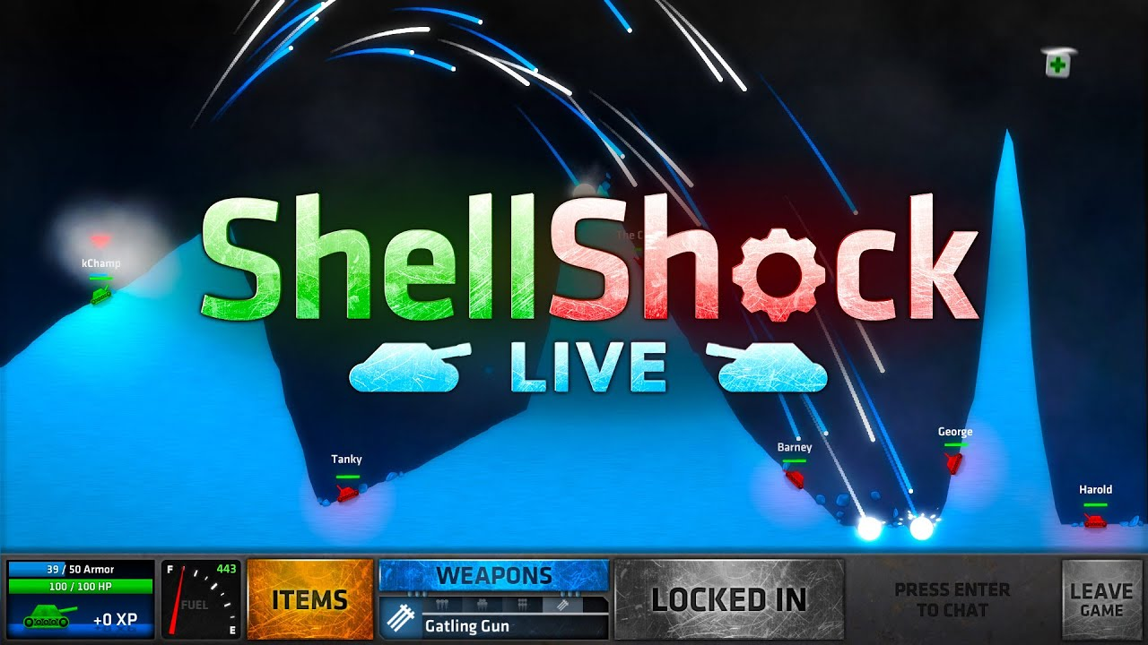
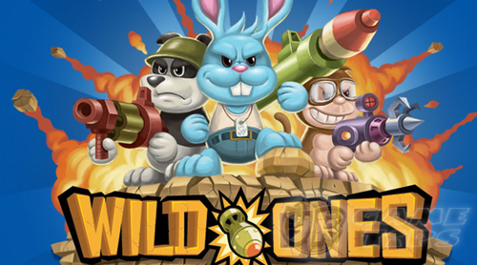
Game Decisions
Unity
Better than Game Maker and Unreal for 2D games (From what we know)
Prior experience
Why inspired by worms?
Popular game style
Turn-based system allows multiplayer with one computer

Slide 4
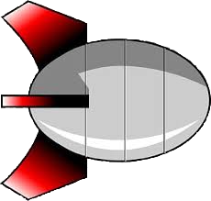

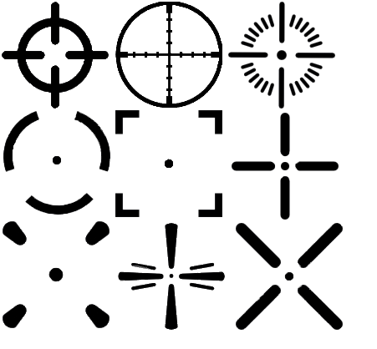









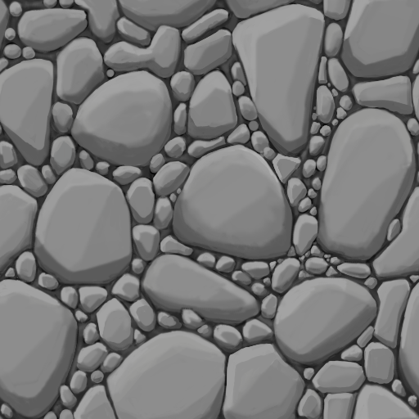

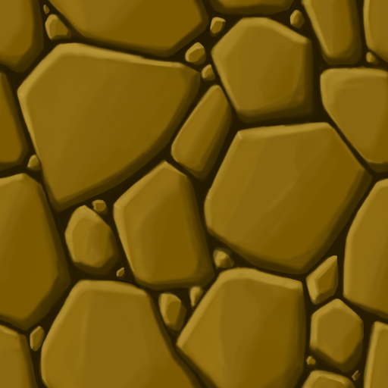
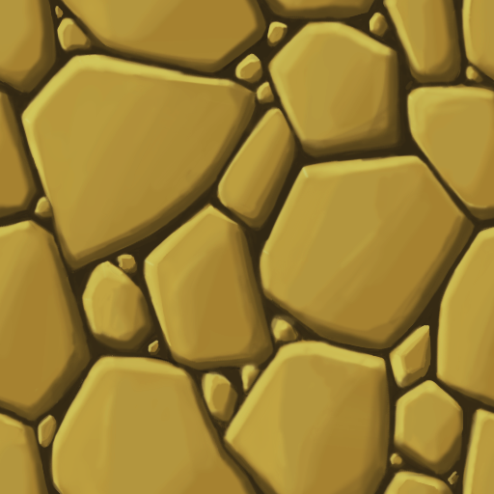
Art

Slide 5



Audio
We plan on finding fitting audio for ambient sounds, shooting, movement, the main menu, explosions, etc.
If we can’t find existing sound FX we will make our own.
But we currently have no plans on making our own music.

Slide 6
Task Breakdown
Alex
AI movement decisions, Menus like main menu, arsenal, pause, settings, etc.
Fernando
AI shooting calculations, Weapons, Gameplay, Destructible terrain, Player controllers.
Joseph
AI target decisions and weapon selection, Map Creation, Environment Interaction and hazards, Sounds
All
Implementing Guns, AI, Game Manager, Art, Testing and Documentation.

Slide 7
Schedule
Create some weapons, characters, map
Write game logic for player interaction with weapons
Create menu to control game settings
After game is playable with less features, add:
Basic AI
Destroyable, dynamically generated map/environment
Weapon/Tool Drops
Implement environment interaction
Add more weapons, players, more complex AI

Slide 8
First Playable
One complete map, with audio
Basic menu (enough to set up a game)
Game flow
Can go through a full game
One weapon of each type, with audio
Gun, launcher, close range
Destructible terrain
Player Movement animations
Explosion effects

Slide 9

Questions?

